Slide 1
Enterprise Systems
Chap#10

Slide 2
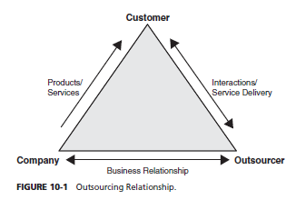
OUTSOURCING
What Is Outsourcing?
Outsourcing occurs anytime a company decides to subcontract its business processes or functions to another company; therefore, instead of hiring employees to perform a task, the company (outsourcer) enters into an outsourcing arrangement with another firm (outsource) to provide these services under contract for a certain price and period.

Slide 3
key benefits of Outsourcing
• Economics. Outsourcing provides a predictable monthly payment. A company can solve all of the problems of running an application at a lower cost. Outsourcing enterprise applications can save a company anywhere from 30 to 50 percent, depending on the task, method, location, and how the relationships are structured.5
• Market agility. Outsourcing the ERP function offers a faster time to solution and removes a major distraction from a company’s core competence.
• Breadth of skills. Many organizations do not have in-house personnel with ERP implementation and maintenance skills. Outsourcing provides an avenue to access these advanced expertise areas quickly.
• Technical expertise. Outsourcing arrangements cost-effectively enable a company to provide access to cutting-edge IT solutions to its employees and clients. Such service providers as Accenture and IBM typically have alliances with such key ERP vendors as SAP and Oracle, which puts them in the loop of the newest and latest changes in the applications.
• Multiple feedback points. Outsourcing provides an organization with an outside or external perspective during implementation and maintenance.
• Best practices. Outsourcing can provide companies with access to best practices in ERP planning, implementation, and maintenance.
• Scalability. One secondary benefit to outsourcing is flexibility for the company to grow or shrink quickly, depending on the market demand for its products and services. Outsourcing agreements allow companies to scale their service agreements with minimal disruption as opposed to doing them in-house.
• Process-oriented. Outsourcing, by default, forces process perspective (i.e., cross-functional teams, customer focus) rather than a functional perspective, which is common inside organizations. This ensures timely delivery of quality solutions at lower costs.
• Solution centric. Outsourcing allows companies to work with both third-party components and custom-developed code to meet ERP requirements at the best possible value.
• Upgrade crunch. ERP systems are high-maintenance software that requires constant upgrading and patching after implementation. It is hard for most businesses to keep up with these constant maintenance cycles, especially if they have customized the ERP application during installation.
• Fear of distraction. Outsourcing allows the company employees to focus on their core competencies and not get distracted by activities that lower employee productivity.

Slide 4
key drawbacks of Outsourcing
Lack of expertise An external company may not know or have the expertise to understand the in-house-developed application or how to accommodate ERP extensions.
Misaligned expectations. Companies outsourcing often cannot anticipate changes in their business circumstances or in technology.
Culture clash. The business processes and mannerisms followed by the outsourcing organization could be very different from the organization’s culture.
Hidden costs. Surprise or unanticipated charges like travel costs, monitoring costs, lower productivity, and long-term loss of relationships with clients are hard to determine.
Loss of vision. Outsourcing arrangements often result in a loss of institutional knowledge.
Security and control. Outsourcing requires companies to share their trade secrets, which can be risky in a competitive environment.

Slide 5
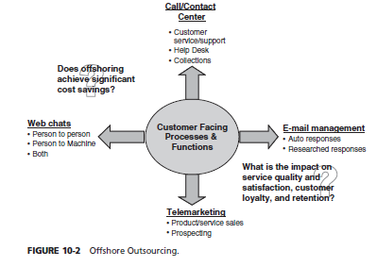
Offshore Outsourcing
When a company selects an outsourcing partner (outsource) from another country, it is called offshoring. Offshore partners are often selected from developing countries to lower the labor costs.

Slide 6
GLOBAL ERP VENDOR SELECTION
In order to create a successful outsourcing or offshoring project, companies need to perform due diligence in vendor selection. When evaluating an outsourcing partner, ERP selection teams should consider financial status, technical certifications , licenses, qualifications, and related work experience.
One of the biggest challenges facing companies that offshore their ERP initiatives is culture.

Slide 7
Software as a Service (SaaS)
Software as a Service (SaaS) is a model of software that can be rented or leased from a software vendor that provides maintenance, daily technical operation, and support for the software. SaaS is a model of software delivery rather than a market segment; it assumes the software is delivered over a secure Internet connection.
The SaaS model brings lower risk in the implementation cycle and better knowledge transfer from integrators to users of systems.

Slide 8
BENEFITS OF THE SAAS MODEL
Universal access. Most information workers have access to a computer and are familiar with conventions from mouse usage to Web interfaces.
Ubiquitous computing. In the past, corporate mainframes were jealously guarded as strategic advantages. The applications were later viewed as strategic.
Standardized applications. With some notable, industry-specific exceptions, most people spend most of their time using standardized applications.
Parameterized applications. In older applications, the only way to change a workflow was to modify the code. Many SaaS providers allow a wide range of customization within a basic set of functions.
Global market. A company that made software for human resource management at boutique hotels might once have had a hard time finding enough of a market to sell its applications.
Reliability of Web. Despite sporadic outages and slowdowns, most people are willing to use the public Internet, the hypertext transfer protocol, and the TCP/IP stack to deliver business functions to end users.
Transparent security and trust. With the broad adoption of SSL and HTTPS protocols, organizations have a way of reaching their applications without the complexity and burden of end-user configurations or VPNs.

Slide 9
LIMITATIONS WITH THE SAAS MODEL
SaaS is conceptually similar to the original mainframe computing model that had a centralized control, minimal user privacy, and limited flexibility allowed to the individual user.
Many users (e.g., traveling salespeople) with expensive wireless connections need access to data in offline mode.
There is no large investment for software license at the onset of the project, the ongoing costs of SaaS are categorized as monthly expenses and do not depreciate over time as would a capital investment of perpetual software licenses which ERP donot support.
It is quite possible that over a three-or five-year period, traditional ERP architecture might even be cheaper than a SaaS solution.

Slide 10
Outsourcing Best Practices
Balancing outsourcing and in-sourcing approaches can be a complex process, but the relationship can yield very successful results when done correctly.
To maintain a higher success rate with outsourcing and offshoring ERP implementations, two best practices have emerged. First, a better way to manage the offshore relationship through a practice called “in-sourcing,” where good ERP managers invite a representative or entire team to work on-site. The second emerging best practice is for the creation of a formal governance process to manage the offshore relationship.
Vendor governance is becoming a critical success factor and must include global relationships and business-process outsourcing with formal methodologies followed to refine quality and improve consistency.
ERP experts say it’s never too soon to plan for installing upgrades, maintaining modules, troubleshooting problems, and policing platforms once the software enters the longest phase of its life cycle—ongoing operations.
ERP implementation teams should not consider outsourcing and offshoring when they want someone else to take accountability or to deflect blame in the event something unfortunate transpires.

Slide 11
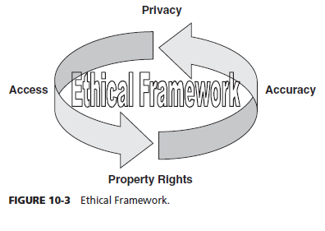
ETHICS
Ethics is a general term for what is often described as the science of morality. In philosophy, ethical behavior is that which is good or right in a certain value system . The ERP system integrates information from various departments of the organization . Ethical violations cannot be curbed unless they are made part of the law.
Ethical Principles
information technology can impact ethics in four ways, which can be summarized by means of an acronym, PAPA, which stands for privacy, accuracy, property, and accessibility. Privacy is concerned with how personal information is safeguarded in the system. Accuracy requires systems to validate the correctness of the data in the system and who is responsible for this accuracy. Property governs who has ownership rights to the information. Accessibility is concerned with who has access to what information.

Slide 12
Code of Ethics for ERP
There are three normative theories of ethical behavior that can be used by organizations to influence the ERP implementation. They are as follows:
• Stockholder theory. Protects the interest of the investors or owners of the company at all costs. This is the ultimate implementation of the free market concept, where the responsibility of management is to maximize profits with legal and non fraudulent methods.
• Stakeholder theory. Protects the interests of everyone having a stake in the company success, namely, owners and stockholders, employees, customers, vendors, and other partners. Management using this theory has to balance the interest of these various groups while making organizational decisions.
• Social contract theory. Includes the right of society and social well-being before the interest of the stakeholders or company owners. Management using this theory must think of the well-being of society first (e.g., protecting the environment or helping the socially challenged individuals before thinking about profits of the organization).

Slide 13
GREEN COMPUTING
Countries around the world are trying to take the initiative and reduce the amount of wasted resources and pollution of our planet. This is especially true for businesses that are faced with increasing energy costs and an expanding need for power consumption. Governments and companies are working hard to portray themselves as being “green.”
Green is not only good for the environment but also for business. Today, a green company is viewed as a responsible and caring company. Poland Spring, for example, has reduced the amount of plastic it uses in its water bottles.
A company going green can also cut costs by eliminating waste and being more efficient.
Companies can go green simply by successfully implementing an enterprise resource program. They have eliminated much waste by incorporating best practices into their software.
Customers are also able to view order statuses and obtain much product information online, eliminating the need for printed product catalogs or printed receipts. This can save much on paper and ink costs.
Consumers are also aware of this rating, allowing them to make a smarter decision in purchasing a machine that will reduce electricity costs for the home or business.
It can significantly reduce the amount of hardware necessary for an ERP implementation.
Ideally ERP will help organizations to become wholly green and be able to recycle all of their energy and hardware.

Slide 14
SECURITY
Today’s ERP systems are largely Web browser based, meaning they can be accessed anytime and anywhere so security is more important.(Diagram from book)
USER ID AND PASSWORDS : It is vital for HR to work with IT security to ensure that only active employees have appropriate access to the system.
PHYSICAL HARDWARE SECURITY : It used to be that physical access to the computer center was a big exposure or risk to the system security.
NETWORK SECURITY : All need to work together to ensure the network environment remains secure and stable. Network security is one of the more complex IT jobs around today.
INTRUSION DETECTION : Network and server intrusion detection comes in many forms of hardware and software.

